Slide 1


Internship Report: Week 3 (9th to 13th June)
Rane Steering Systems - R&D division
Presented by: Mohnish Raja • 13/06/2025

Slide 2
Study 1 - Electric Power Steering (Ongoing)
Objective of the Study:
To understand the construction, working principles, key components, and torque transmission path of the Electric Power Steering (EPS) system.
Introduction to EPS:
Electric Power Steering (EPS) is an advanced steering system that uses an electric motor to assist the driver in steering the vehicle. Unlike hydraulic or manual systems, EPS provides assistance based on electronic control logic and sensor inputs.
It eliminates the need for power steering fluid and offers better efficiency, lighter packaging, and integration with safety features such as lane-keeping assist and self-parking.

Slide 3
Components Identified
Steering Wheel
Torque & Angle Sensors
ECU
Electric Motor
Reduction Mechanism(eg. Worm Gear)
Intermediate-Shaft
Column Shaft

Slide 4
Working Principle
When the driver turns the steering wheel, the torque sensor detects the applied input torque. This signal is processed by the ECU, which calculates the required assist based on vehicle speed and steering input.
The ECU then sends a command to the electric motor to deliver the necessary torque via a reduction gear mechanism, either at the column, pinion, or rack. The assist torque reduces the effort needed by the driver, especially at low speeds.
Inputs: Torque, Vehicle Speed, Steering Angle/State
Processing: Done by the ECU, calculates required assist torque and sends the corresponding current to the electric motor to produce the assist torque.
Outputs: Assist Torque

Slide 5
Learnings (to be contd..)
EPS is not just a mechanical system but a mechatronic integration of electronics, sensors, and actuators.
The tuning of assist levels significantly affects steering feel and safety.
Understanding EPS requires familiarity with both mechanical layout and control algorithms.
Packaging constraints in EPS systems are crucial, especially around the column where tilt and telescopic mechanisms coexist with assist components.
Assist motor torque must be reliably transmitted without affecting driver feedback and safety in crash scenarios.

Slide 6
Next Steps
To study more in detail about the construction of the EPS, its manufacturing and testing processes.
Study different EPS variants in detail: column-assist vs pinion-assist vs rack-assist and also discuss with senior engineers and mentors.

Slide 7
Study 2 - CAE performed for Steering Columns
Objective:
To understand common CAE (Computer-Aided Engineering) observations for steering columns in both manual and EPS variants, focusing on typical failure zones, stress concentration areas, and structural design challenges.
Method:
Majorly 6 types of simulations are performed:
Static Structural
Crash & Collapse
Kinematic/ Motion Simulation
Fatigue & Durability
Torsional Stiffness, Backlash
NVH

Slide 8
Observations & Learnings
Geometry transitions (e.g., slots, weld joints) need smooth stress paths to avoid peak stress points.
Design for manufacturability (DFM) should go hand-in-hand with CAE to ensure realistic simulation models.
Material properties and actual joint behavior (e.g., bolt preloads, friction, play) significantly affect results.
Setting appropriate Boundary Conditions, external loadings and material selection are the three most important things to do in CAE. It also includes solver setup and post - processing setup.
Saw how the setup for simulation is done in ABAQUS.

Slide 9
Study 3 - Approaches to Introducing Innovation in an Automotive Component
Objective:
To understand the process of introducing innovations in any component by studying real-world examples and design evolution. The goal was to understand the factors driving innovation, such as performance, safety, manufacturability, and cost, and to identify methods used to integrate new ideas into existing product lines.
Component & the corresponding Innovation :
Replacing serrations on the I-shaft with ball-slider.

Slide 10
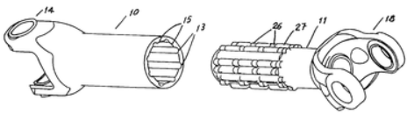
Observations & Learnings
Since serrations are breaking after few years in I-shafts, the use of a butterfly-like four lobe profile with GLODEL coating(anti-corrosive and lubricant) was thought of.
But the coating comes off after 10 to 15 years of use, hence it was decided to implement a ball-slider on the I-shaft, having 6 rows and 6 columns of balls.
This avoids problems like breakage, wear due to friction(since it is point contact) and other issues like NVH, free rotation of shaft, etc.

Slide 11
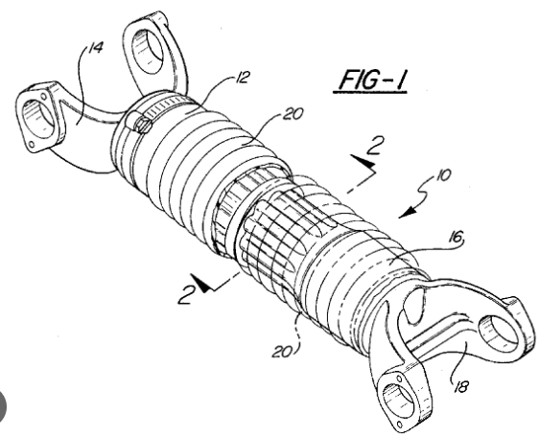
Observations & Learnings
It has much more life, which exceeds the customer requirement. It was also requested by the customer in this case.
It maintains tight fit with minimal play and suits tight spaces better.

Slide 12
Study 4 - Looseness & Rigidity Test
Objective:
To find maximum lash in Universal Joints present in the lower column and I-shaft by applying a torque to the column in CW and CCW directions.
Devices Used:
Dial gauge - To measure linear/angular displacement
Load Cell - To measure external torque applied to the setup

Slide 13
Observations & Learnings
Torques of 1, 3, 5 N-m respectively are applied to the column and the corresponding angular lashes must be less than 10 degrees.
The torques applied are prescribed by the DVP (Design Validation Plan) given by the customer.
Excess lash was mostly observed due to wear in the Universal joint or damage in the bearings inside.

Slide 14
Study 5 - EPS Performance Test
Introduction:
Three major tests are done to analyse the performance of the EPS :
Sensor Characteristics
Input - Output Characteristics
Rotational Torque Characteristics (Didn’t perform due to unavailability of personnel)
The above tests are done to ensure proper working of the Torque Sensor, ECU control logic and a good steering feel(returnability) of the column.

Slide 15
Test 1.a - Sensor Characteristics
Objective: To check if the output voltage signal rightly corresponds to input torque and if the Voltage signal is in required tuning range.
Ex: T = 6 N-m ; V1 = 6 N-m ; V2 = 1 N-m
T = 0 N-m ; V1 = 2.5 N-m = V2
T = -6 N-m ; V1 = 1 N-m ; V2 = 6 N-m
Here, V1 and V2 are 2 voltage signals(to avoid redundancy) and here V1 increases with CW torque and V2 decreases with CW torque.
The Voltages V1, V2 are in range and correspond to the right torque, hence this test has been passed.

Slide 16
Test 1.b - Input - Output Characteristics
Objective: To check if the input torque (T_in) gives the required output torque(T_out, at the rack) with the help of the electric motor in the EPS column.
Ex: T_in = 6 N-m ; T_out = 48 N-m
T = -6 N-m ; T_out = -47.18 N-m
Requirement:
As per customer requirements, a max torque of 6 N-m must give an output torque of at least 42 N-m. From our observation, the requirement is satisfied.
To compare all values, we refer to the graph generated in the computer(next slide).
Our requirement is satisfied, hence this test has also been passed.

Slide 17
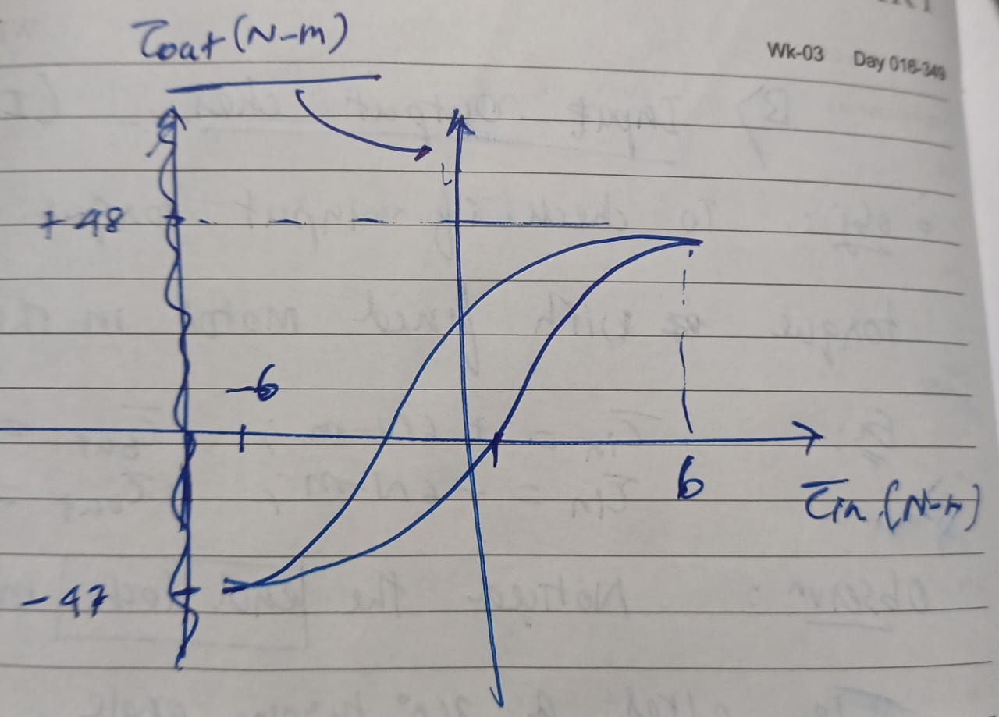
Test 1.b - Input - Output Characteristics
New Concept:
Notice the End-lock mechanism used in EPS where the assist torque from the motor is reduced when the steering angle is greater than a certain value, like 300 degrees.
So for the same input of 6 N-m, the torque output would be 42 N-m, rather than 48 N-m (for example). This is done to give the driver a feel so that he/she knows that the vehicle has turned considerably
Absence of this mechanism might result in the rollover of the vehicle.

Slide 18
Study 6 - Rotational Durability Test
Objective:
To test if the yokes can withstand load given (Torque) involving a Powder Breaker.
Observation:
The yoke is subjected to conditions like spraying with muddy water to check if water enters and also goes thro 1 lakh - 2 lakh cycles of torque application.
If water droplets are found in the yoke after the test, water has entered in and that part would be considered as a failed part.

Slide 19
Study 7 - UJ Articulation Torque Test
Objective:
To check abnormalities like noise when torque is given to a Universal Joint attached to the I-shaft.
Method:
Torque is given to the I-shaft, thereby rotating the weld yoke. Here the clamp yoke is fixed.
Observation:
Learnt the terms spider, NRB(Needle Roller Bearing) and its use.
Abnormalities may occur in the yoke if the NRB isn’t pressed with a proper load during assembly.
A torque of 55 N-m was given to through a torque wrench, the angle through which the lower column rotated was given as 25 degrees.

Slide 20
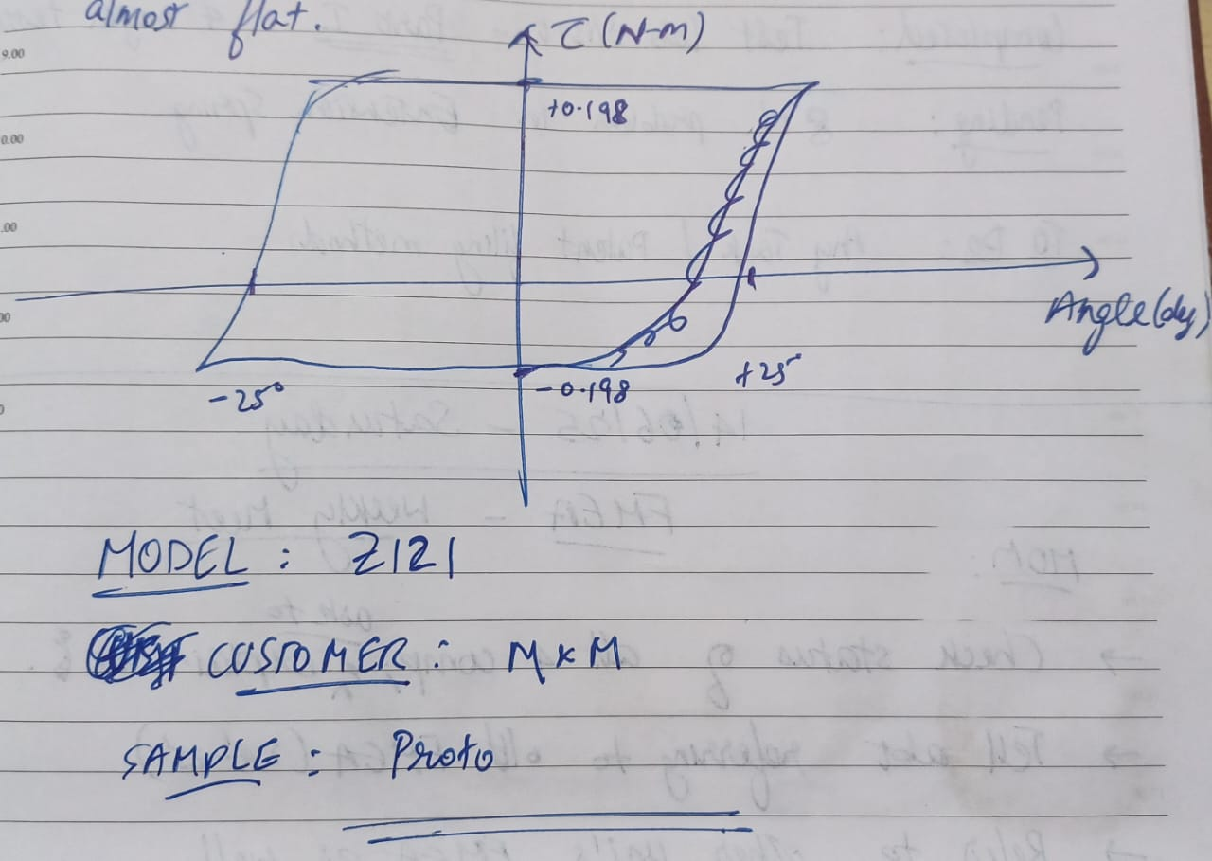
Study 7 - UJ Articulation Torque Test
The parameters like range of torque fluctuation and average torque(0.203 N-m) were recorded.
The curve doesn’t have sudden spikes(shown below). Thereby, we can conclude that no noise was detected.

Slide 21
Thank You!

